Slide 1
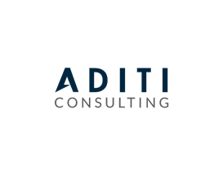














UNLEASH YOUR GREATEST POTENTIAL WITH
ADITI CONSULTING
THE ADITI DIFFERENCE
100% Dedicated Talent Experience Team
Backed by AI/ML driven technology
Competitive Benefits Redeployment Program
When you partner with Aditi, you’re choosing to work with a firm with your best interest in mind. Our dedicated Talent Experience team exists to ensure you succeed. From onboarding to regular check-ins, our team is there every step of the way.
We use tools like Sense to keep you informed about what you need to know when you need to know it.
We offer a highly competitive benefits package which includes health care (medical, dental, vision), 401k plans, life insurance, and more.
When your assignment is over, we’re there to help you find your next career opportunity because when you partner with Aditi, you become part of the family.
BUILDING FOR TOMORROW
With a portfolio of over 70+ Fortune 500 clients, Aditi helps companies like Amazon, Facebook, Salesforce, Microsoft, & T-Mobile build teams, deliver projects, and develop the technologies of tomorrow.
TAKE YOUR CAREER TO THE NEXT LEVEL WITH ADITI
LET’S TALK!
Jacky Schultz
Client Services
E: jackys@aditiconsulting.com
T: (309) 439-9555
Aditi Consulting is a premier talent and technology solutions firm helping organizations accelerate business growth and digital transformation. We partner with Fortune 500 companies who are leading the way to next generation technology.
Learn more at: www.aditiconsulting.com/careers-aditi/

